Slide 1
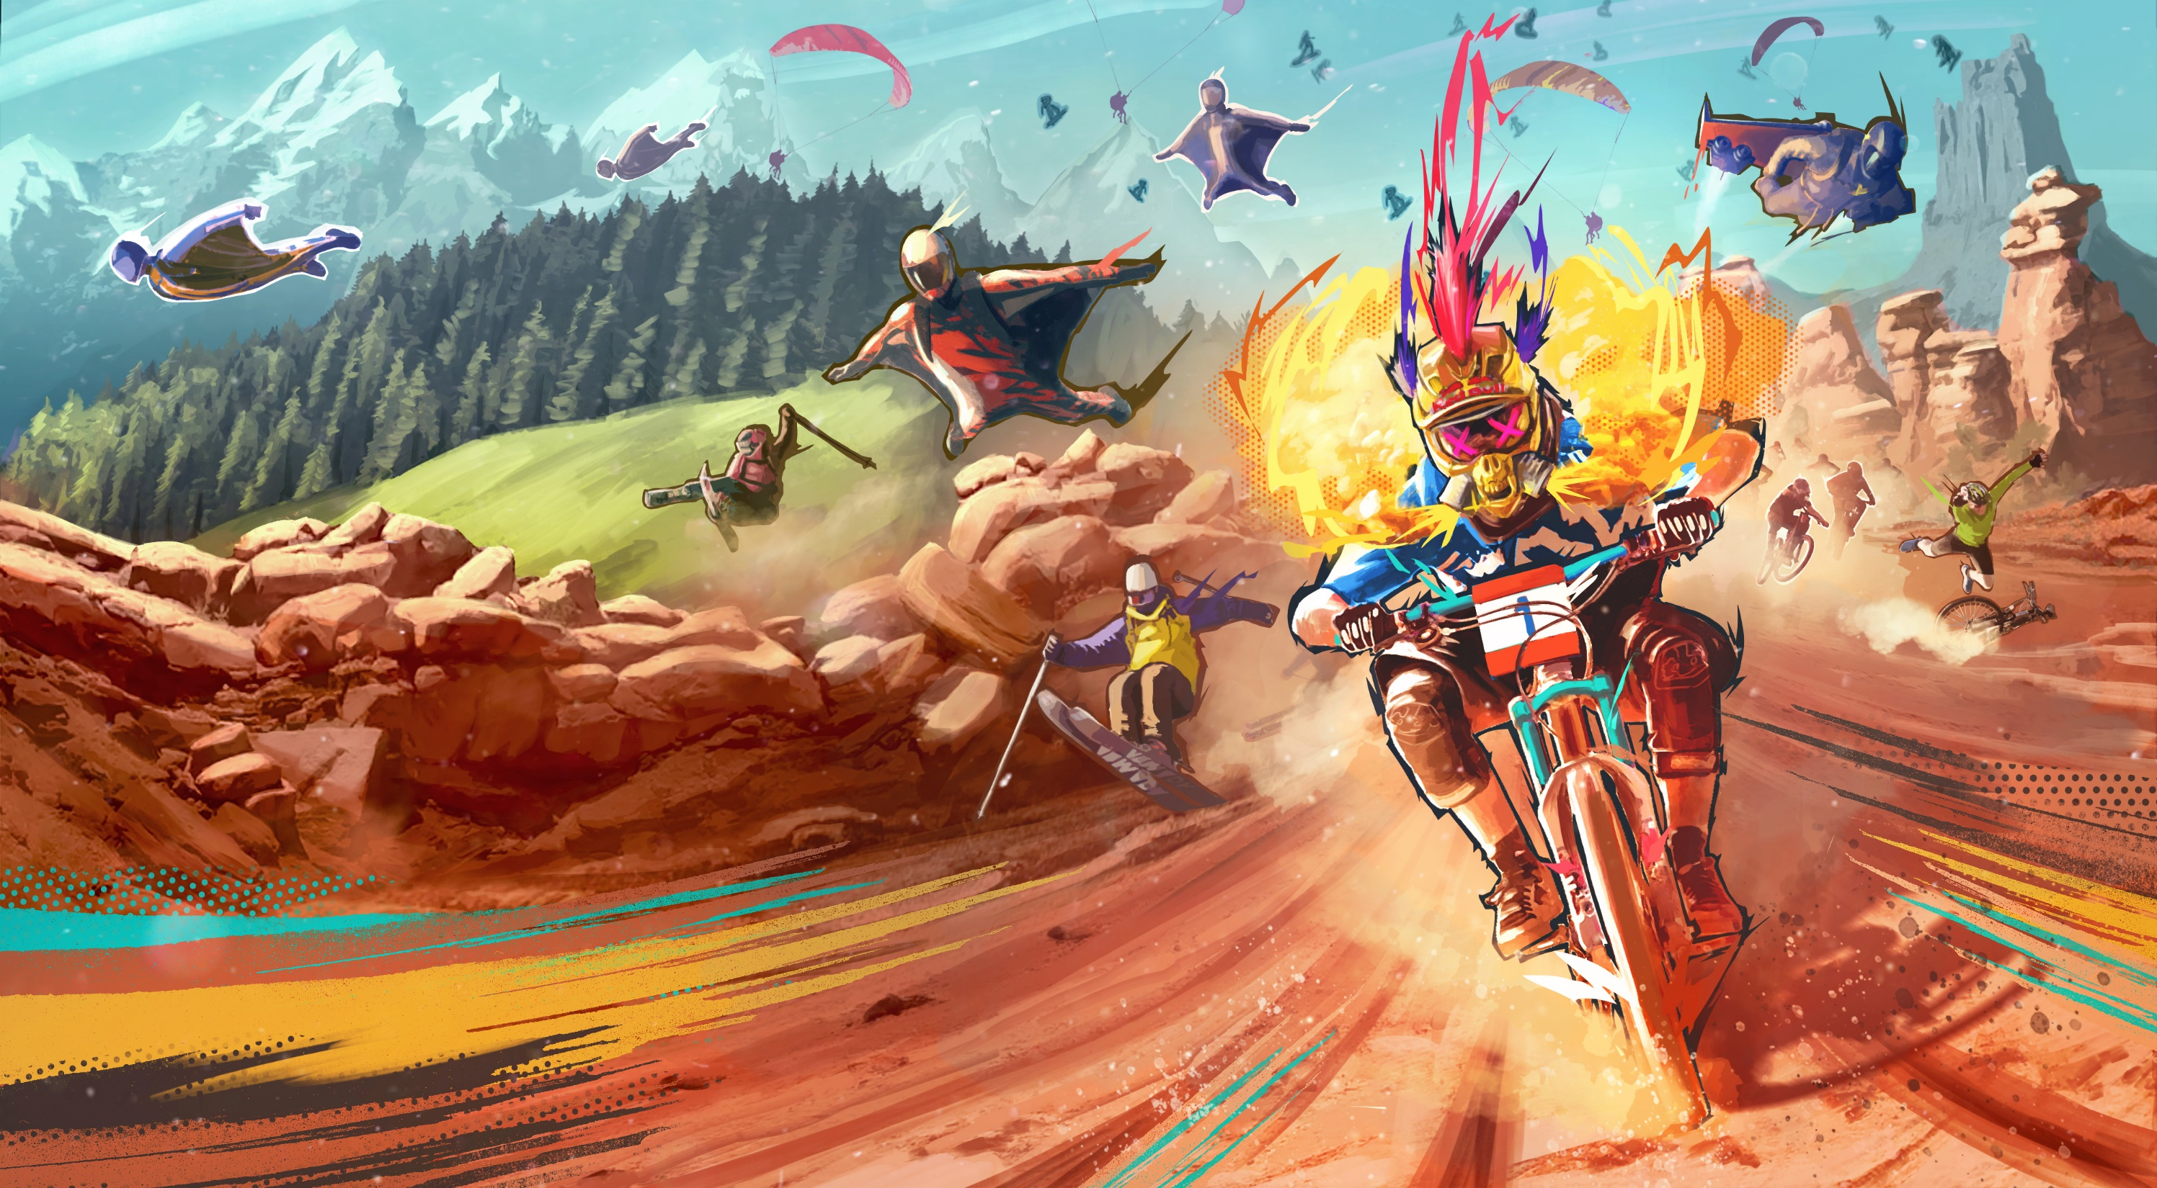
GAME PROGRAMMING IN C++
2020
Notes:
Ovo je prvi čas držan iz karantina, online, zato ima na drugom i trećem slajdu rešenje zadatka sa prošlog časa, onog zadatka koji je trebalo raditi na ovom času da se desio u učionici

Slide 2
Sitne izmene
Obrisao sve copy contructor-e i operatore dodele
Uključio optimizacije u kompajleru (agresivniji inlining, korišćenje SIMD instrukcija)
Probao Clang kao kompajler – testiranje performansi
TextureManager klasa (hashmap tekstura i imena, Create, Get) – pogledati kod van časa

Slide 3
Fizika u igrama
Detekcija kolizija između objekata u igri
Simulacija krutih tela
Uništavanje terena, zgrada i drugih objekata
Raycast i shape cast
Trigger volumes
Vozila
Simulacija tekstila, kose, fluida
Notes:
In the real world, solid objects are inherently, well…solid. They generally
avoid doing impossible things, like passing through one another, all by
themselves. But in a virtual game world, objects don’t do anything unless
we tell them to, and game programmers must make an explicit effort to en-
sure that objects do not pass through one another. This is the role of one of the
central components of any game engine—the collision detection system.
A game engine’s collision system is often closely integrated with a physics
engine. Of course, the fi eld of physics is vast, and what most of today’s game
engines call “physics” is more accurately described as a rigid body dynamics
simulation. A rigid body is an idealized, infi nitely hard, non-deformable solid
object. The term dynamics refers to the process of determining how these rigid
bodies move and interact over time under the infl uence of forces. A rigid body
dynamics simulation allows motion to be imparted to objects in the game in a
highly interactive and naturally chaotic manner—an effect that is much more
diffi cult to achieve when using canned animation clips to move things about.
Even the simplest 2D game needs collision. After all, if the objects in a game can’t
interact, how fun could the game possibly be? Breakout is a great example of a sim-
ple game. A ball bounces off walls, bricks, and the paddle. If you look at it this way,
the core of the game experience is created by the 2D collision algorithm.

Slide 4
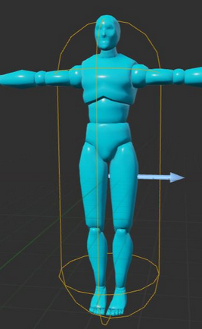
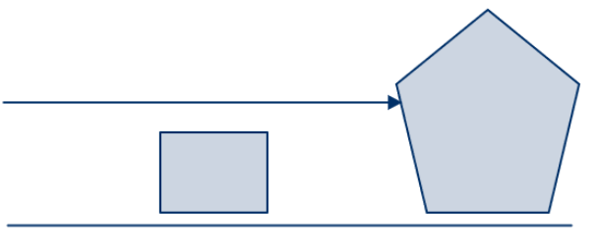
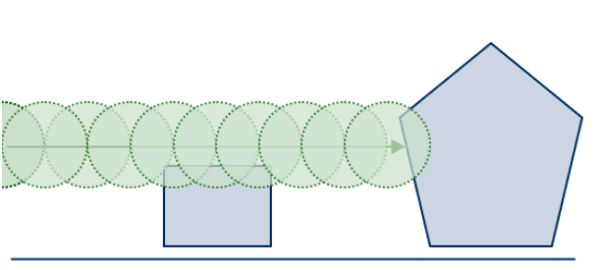
Fizika u igrama
Slobodno kretanje
Pozicija, brzina, ubrzanje, sila, masa, inercija, ugaona brzina, obrtni moment
Interakcija između objekata
Statičko trenje, dinamičko trenje, restitution
Collision mesh (!= visible mesh)
Raycast, Shapecast, collision reporting

Slide 5
Uticaj fizike na druge sisteme
Grafika – utiče na bounding volumes, osvetljenje i senke
Networking – fizika koja utiče na gemeplay „mora“ da se simulira na serveru
Snimanje i playback događaja u igri – Fizika mora biti deterministička
AI – pathfinding
Kompleksniji art pipeline – Objekti moraju da imaju masu, trenje…
Notes:
• Graphics. Physics-driven motion can have an effect on renderable ob-
jects’ bounding volumes (where they would otherwise be static or more
predictable). The presence of destructible buildings and objects can in-
validate some kinds of precomputed lighting and shadow methods.
• Networking and multiplayer. Physics effects that do not affect gameplay
may be simulated exclusively (and independently) on each client ma-
chine. However, physics that has an effect on gameplay (such as the
trajectory that a grenade follows) must be simulated on the server and
accurately replicated on all clients.
• Record and playback. The ability to record gameplay and play it back at a
later time is very useful as a debugging/testing aid, and it can also serve
as a fun game feature. This feature is diffi cult to implement because it
requires every engine system to behave in a deterministic manner, so
that everything will play out exactly in the same way during playback
as it did when the recording was made.

Slide 6
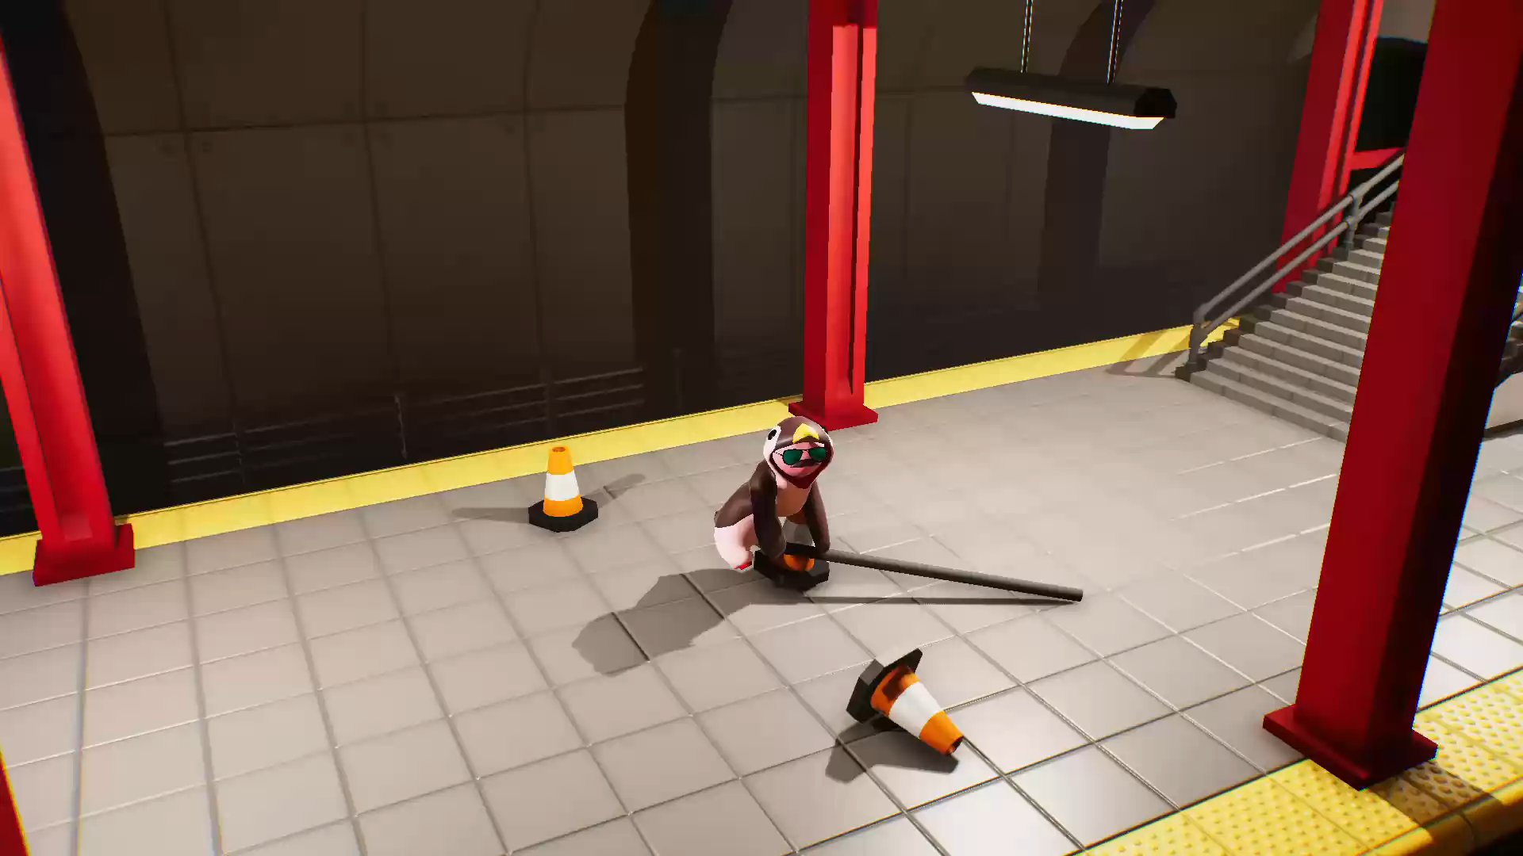

Slide 7


Slide 8
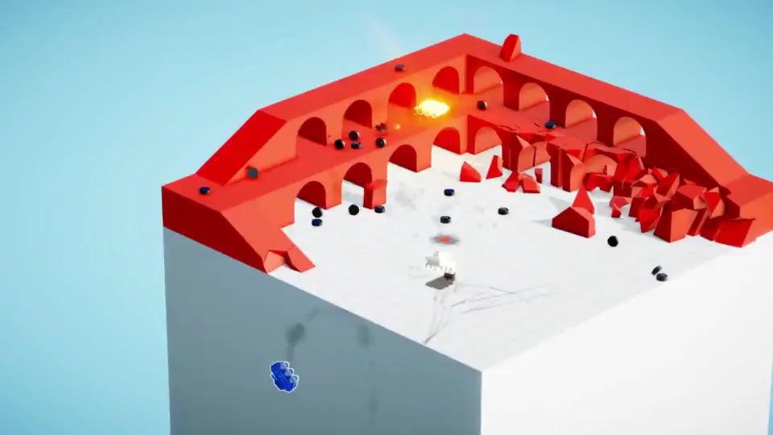

Slide 9
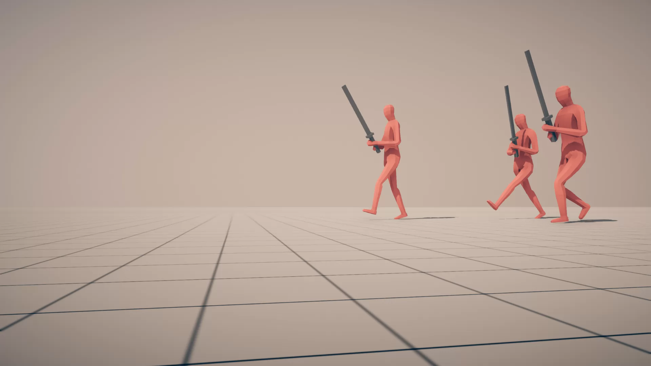

Slide 10
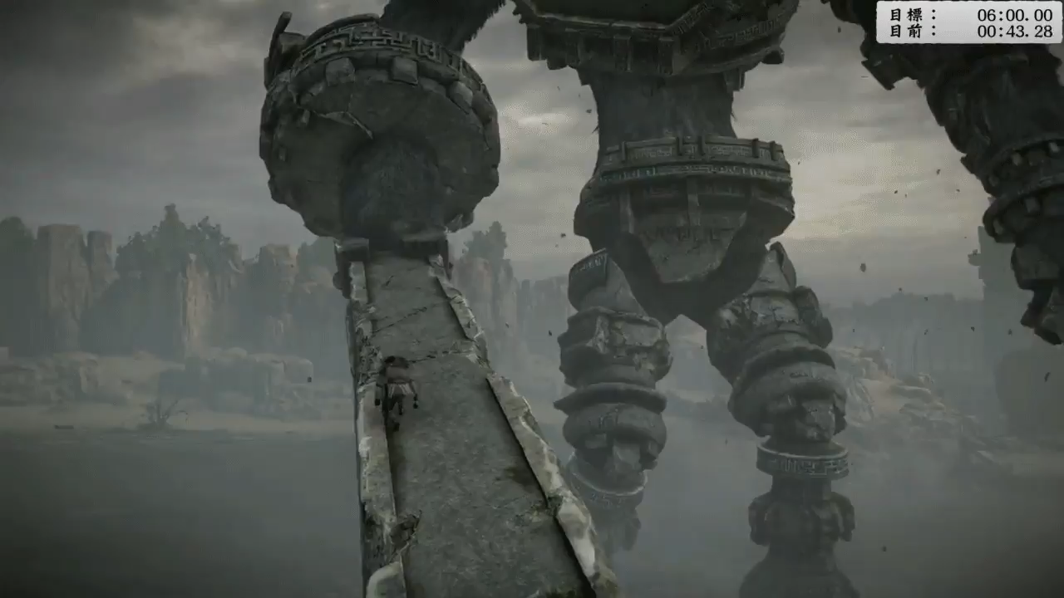

Slide 11
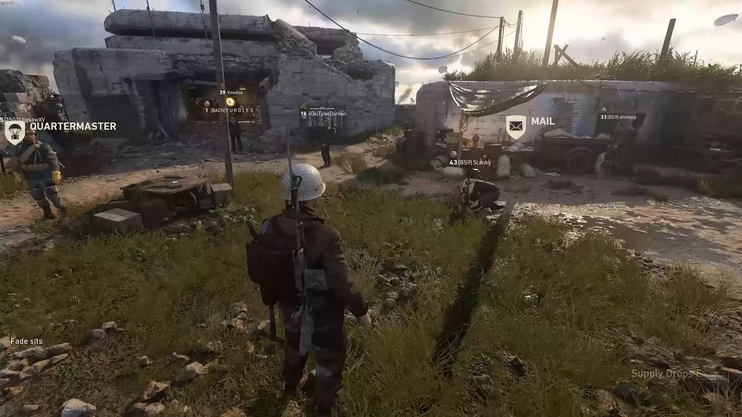

Slide 12
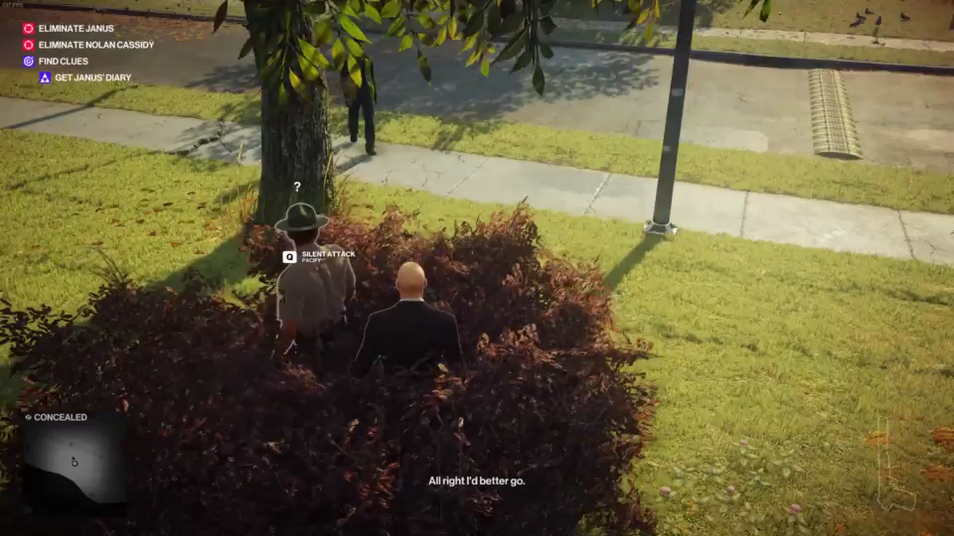

Slide 13
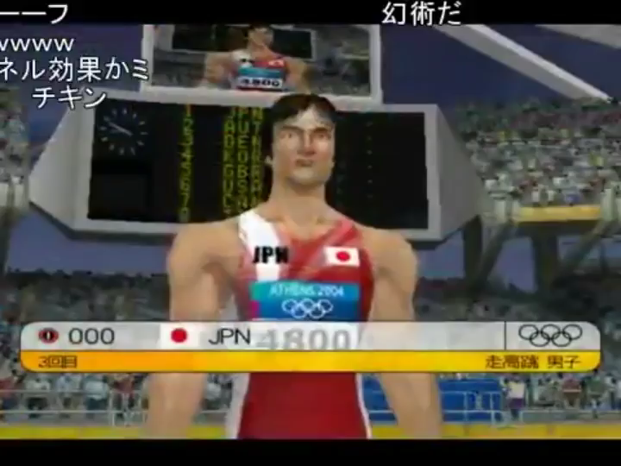

Slide 14
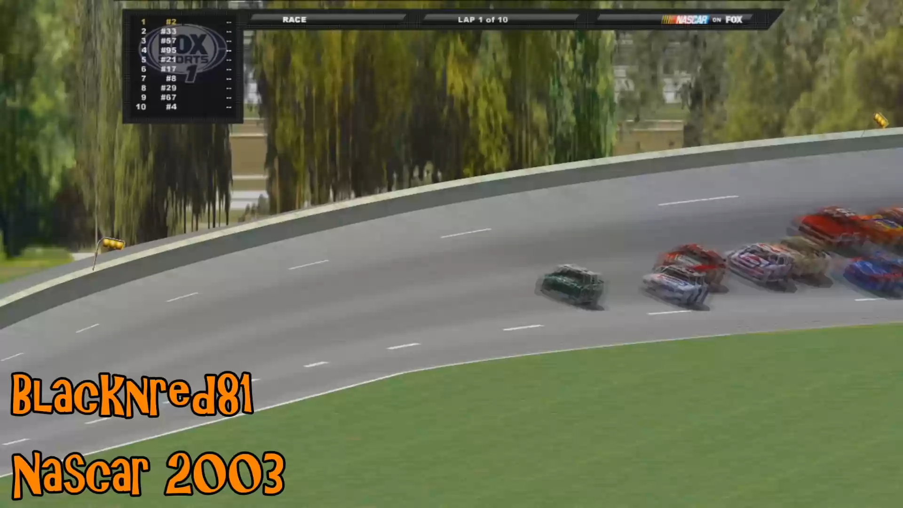

Slide 15


3rd party fizika
Open Source
box2d, box2d-lite, Bullet, Chipmunk, Open Dynamics Engine, PhysX, Unreal Chaos
Proprietary
Havok , Digital Molecular Matter, Unity RigidBody

Slide 16
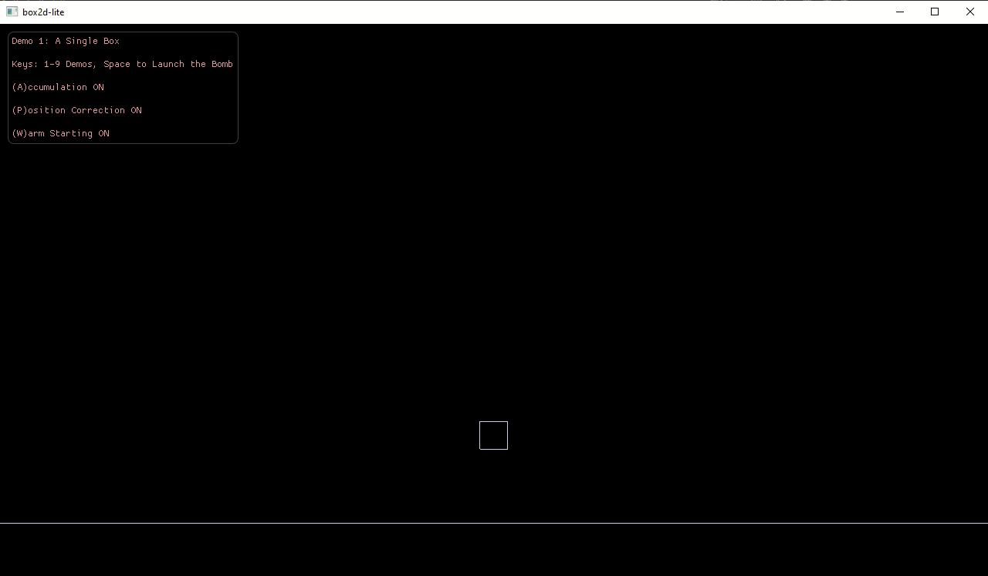
https://github.com/erincatto/box2d-lite

Slide 17
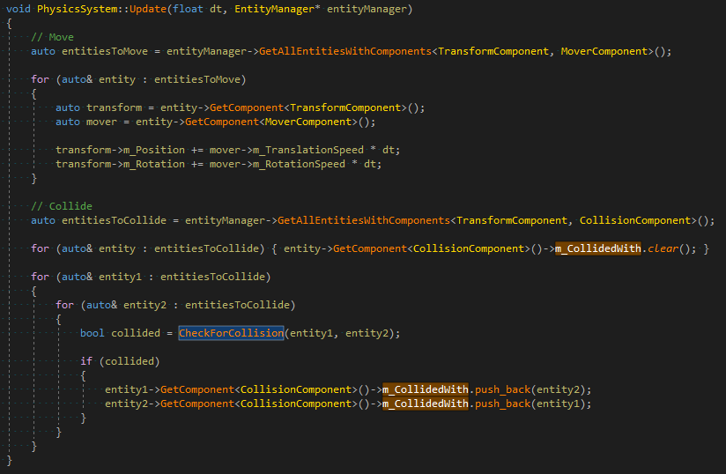
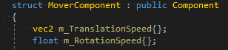
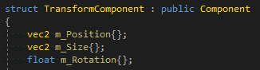
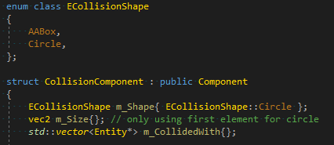
Fizika u našoj igri

Slide 18
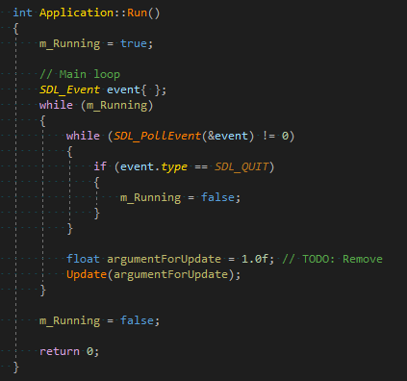
FPS
Update loop
Notes:
Naravno, sama vrednost FPS nam nije toliko bitna, koliko nam je bitno da znamo za koliko treba da updateujemo sisteme.
Priča o dt i vezi između fizike i fps.

Slide 19
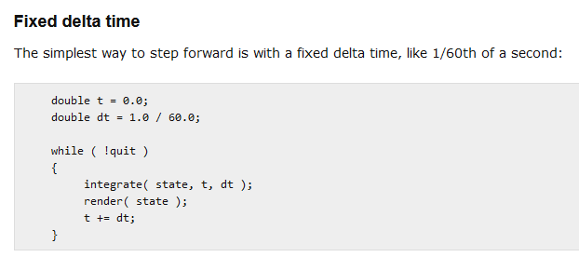
FPS
Update loop
Notes:
In many ways this code is ideal. If you are lucky enough to have your physics delta time match the display rate and you can ensure that your update loop takes less than one frame then you have the perfect solution for updating your physics simulation.
But in the real world you may not know the display refresh rate ahead of time, VSYNC could be turned off, or perhaps you could be running on a slow computer which cannot update and render your frame fast enough to present it at 60fps.
In these cases your simulation will run faster or slower than you intended.

Slide 20
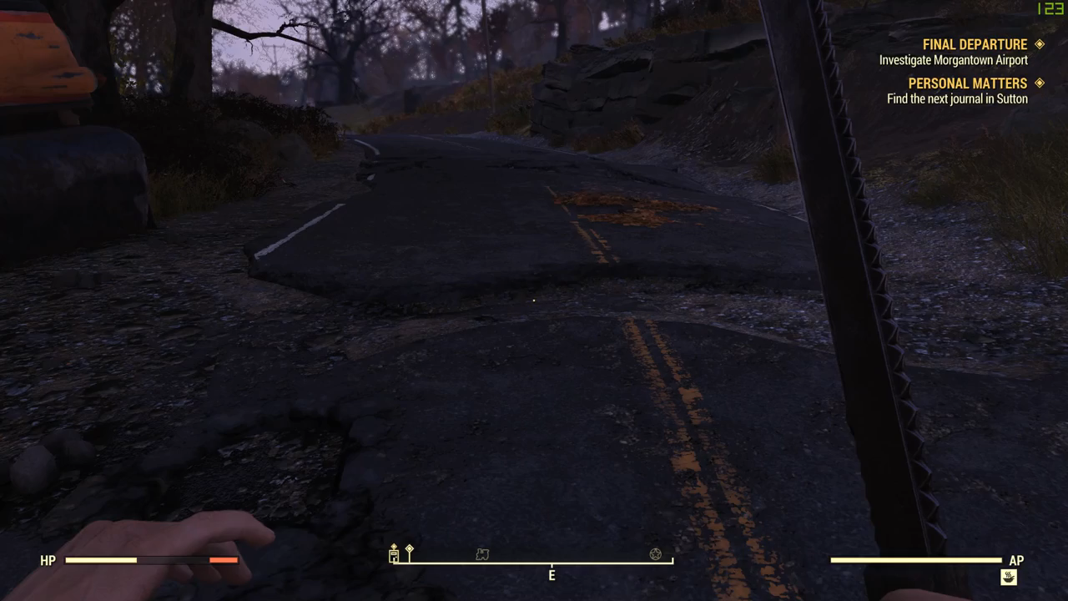
Notes:
https://twitter.com/yungzaniel/status/1057506067071074309?ref_src=twsrc%5Etfw
fallout 76's physics system is tied to it's framerate including your walk speed so you can literally outrun most enemies by looking at the ground

Slide 21
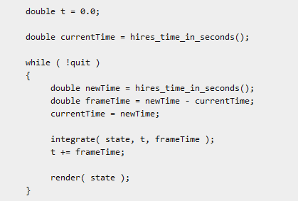
FPS
Update loop
https://web.archive.org/web/20130328024036/http://gafferongames.com/game-physics/fix-your-timestep/
Notes:
Fixing this *seems* simple. Just measure how long the previous frame takes, then feed that value back in as the delta time for the next frame. This makes sense because of course, because if the computer is too slow to update at 60HZ and has to drop down to 30fps, you’ll automatically pass in 1/30 as delta time. Same thing for a display refresh rate of 75HZ instead of 60HZ or even the case where VSYNC is turned off on a fast computer:
But there is a huge problem with this approach which I will now explain. The problem is that the behavior of your physics simulation depends on the delta time you pass in. The effect could be subtle as your game having a slightly different “feel” depending on framerate or it could be as extreme as your spring simulation exploding to infinity, fast moving objects tunneling through walls and the player falling through the floor!
One thing is for certain though and that is that it’s utterly unrealistic to just expect your simulation to correctly handle *any* delta time passed into it. To understand why, consider what would happen if you passed in 1/10th of a second as delta time? How about one second? 10 seconds? 100? Eventually you’ll find a breaking point.
ZA NAS JE TO DOVOLJNO DOBRO

Slide 22
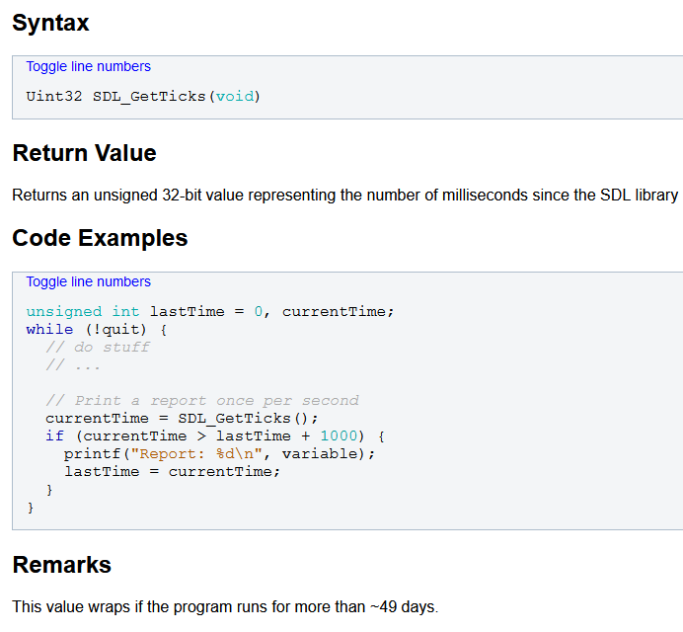
FPS
https://wiki.libsdl.org/SDL_GetTicks
Notes:
Ok, 32-bit, računamo da niko neće držati igru pokrenutu 49 dana. Ali preciznost od 1ms može da bude ok, ali može i da ne bude, da li imamo neku mogućnost da to poboljšamo?

Slide 23
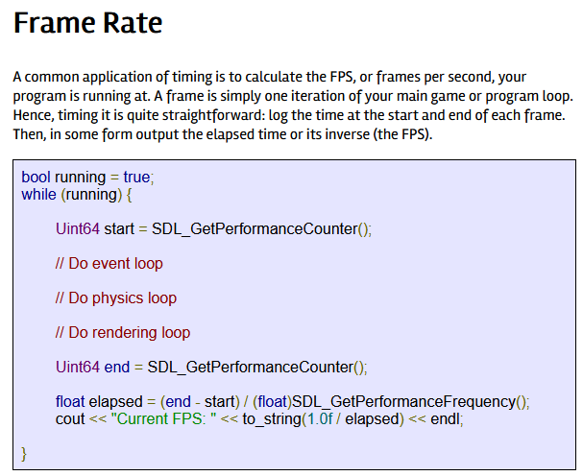
FPS
https://wiki.libsdl.org/SDL_GetPerformanceCounter
Post C++11, možemo da koristimo i std::chrono
https://thenumbat.github.io/cpp-course/sdl2/08/08.html
Notes:
Ok, 32-bit, računamo da niko neće držati igru pokrenutu 49 dana. Ali preciznost od 1ms može da bude ok, ali može i da ne bude, da li imamo neku mogućnost da to poboljšamo?
Možemo čak i u svaki objekat da stavimo lastUpdated varijablu pa da tako proveravamo

Slide 24
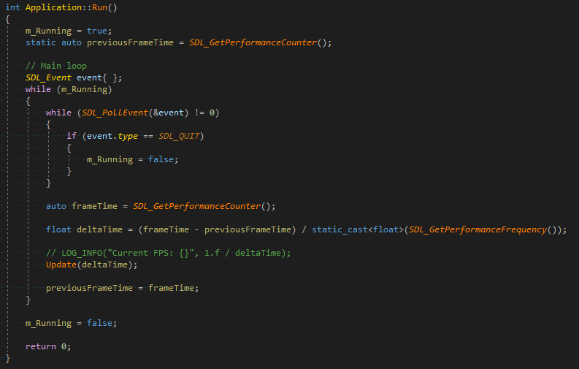

Slide 25
The Game
Želimo da koristimo isti engine za sve igre na ovom kursu
Želimo da odvojimo zajedničke funkcionalnosti od specifičnih

Slide 26
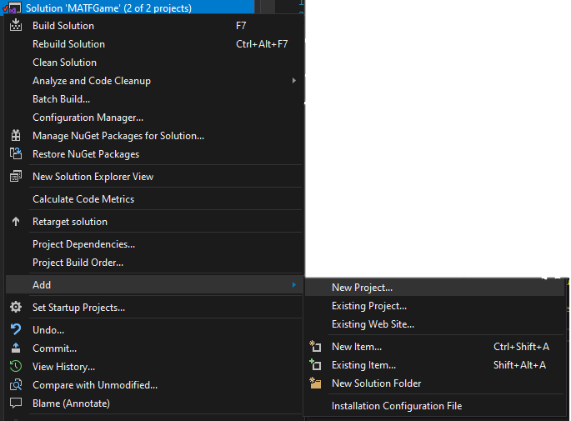
The Game
Empty Project -> Game Name
Notes:
- Set as startup project

Slide 27
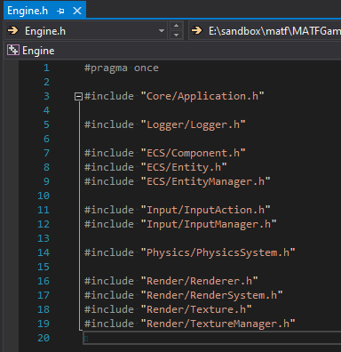
The Game
Treba nam način da include-ujemo tipove iz Engine.h
Pošto je Engine biblioteka, možemo da uradimo isto što i SDL, ubacimo sve javne Engine headere u novi fajl: Engine.h, koji dodamo u precompiled header Game projekta

Slide 28
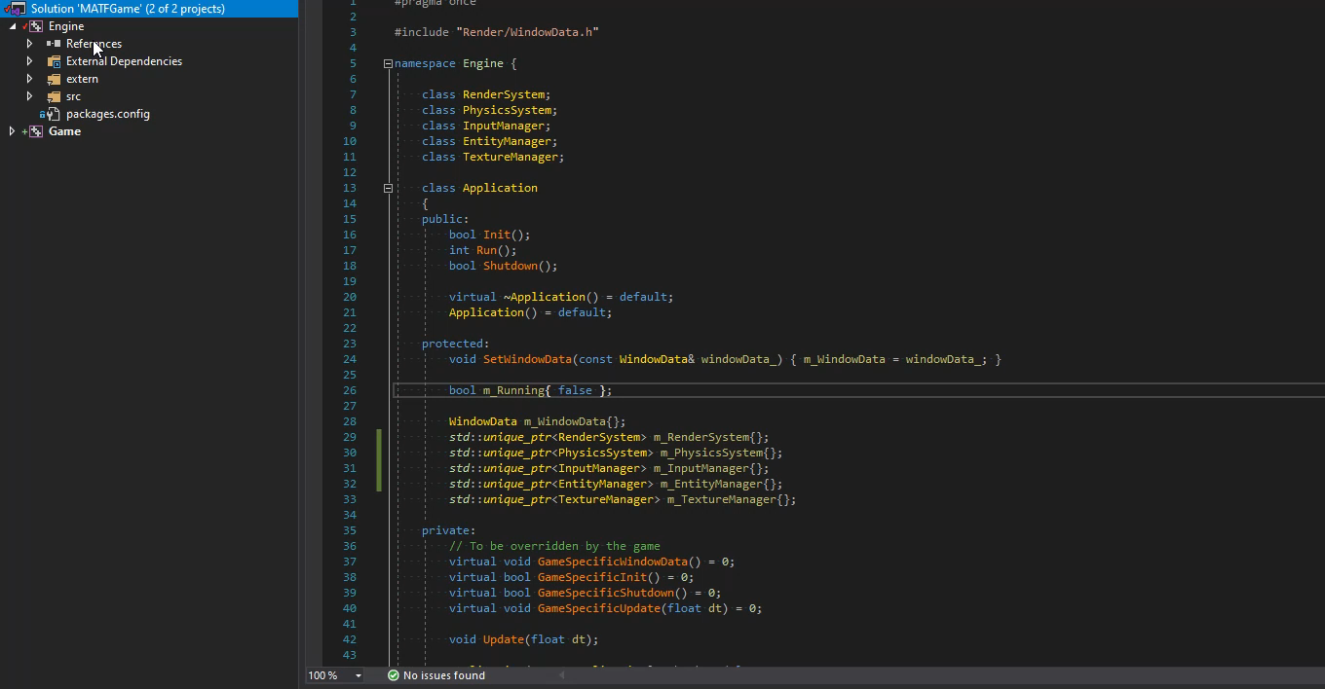
The Game
Pošto koristimo nuget i SDL kao dll, i ovaj novi projekat mora da ima SDL2 i SDL2_image kao zavisnosti ☹
Druga zavisnost je sam Engine projekat

Slide 29
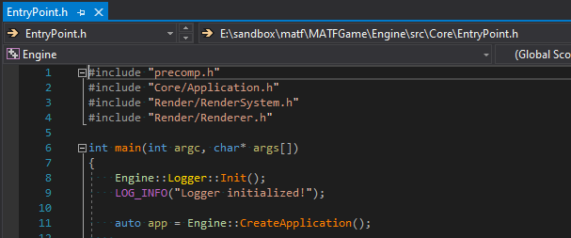
The Game
Ukoliko želimo da dodajemo ručno neke biblioteke: https://docs.microsoft.com/en-us/cpp/build/adding-references-in-visual-cpp-projects?view=vs-2019
Ne želimo da korisnici imaju mogućnost da menjaju main()

Slide 30
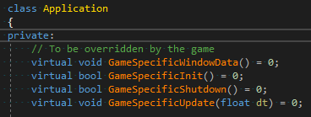
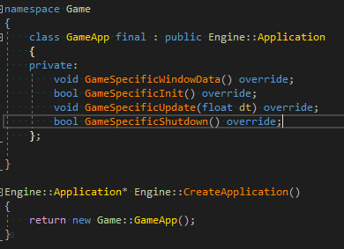
Game-specific code
Notes:
I ubacimo ih na odgovarajuća mesta u Application.h -> pogledajte kod
Možemo i samo da overrideujemo Init, Update i Shutdown, ali onda moramo da nateramo korisnike da zovu Application::Init() iz glavne klase

